Slide 1
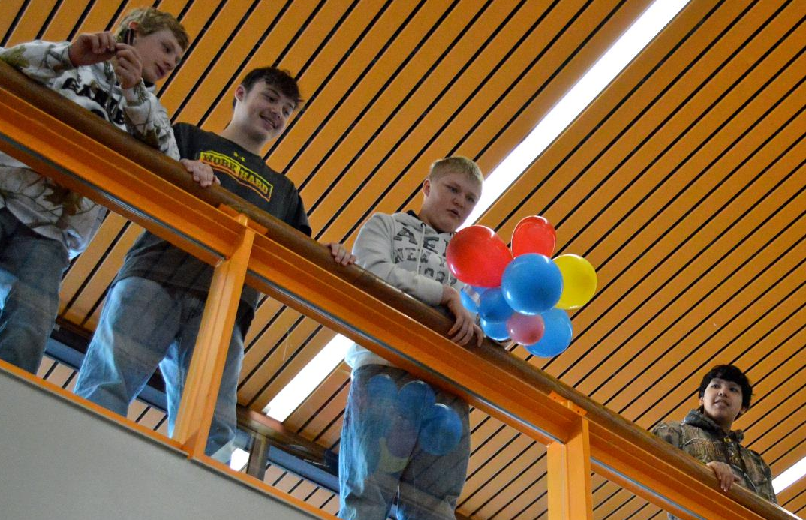
get the facts

Slide 2
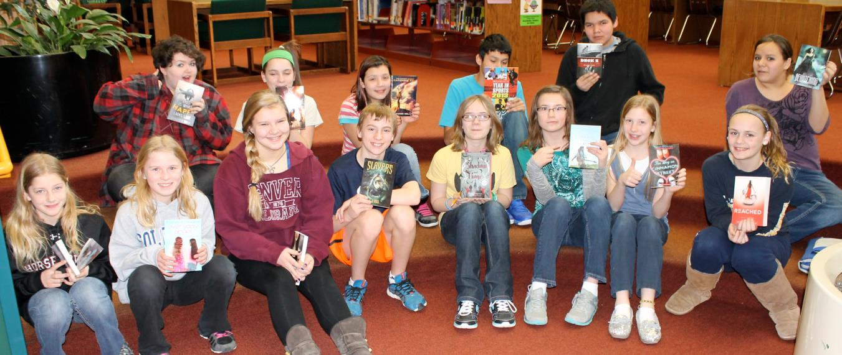
how we got here
listening sessions & facilities survey
20 community meetings
From January 2014 to July 2014
Hundreds of community members engaged

Slide 3
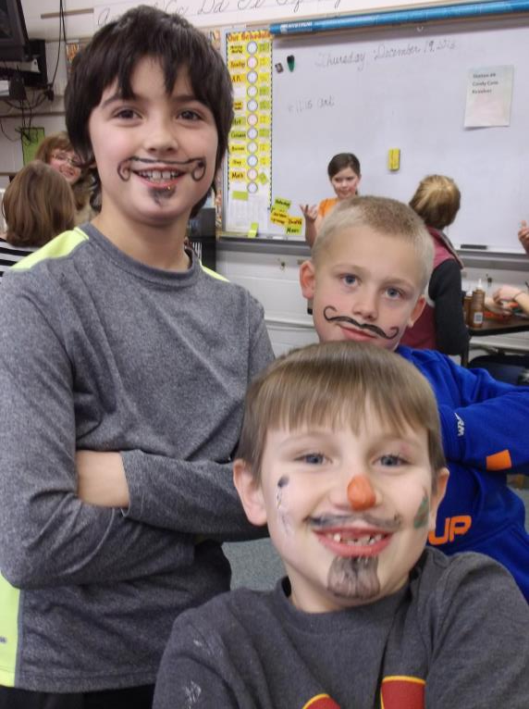
how we got here
listening sessions & facilities survey
The primary issues identified include:
Increasing student enrollment at elementary level
Bemidji Middle School’s indoor air quality
The need for additional indoor activity space

Slide 4
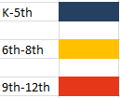
challenges
enrollment growth
Enrollment by Grade Groupings
(based on birth rates)
2712 students
2028 students
Number of students
07 08 09 10 11 12 13 14 15 16 17 18
year

Slide 5
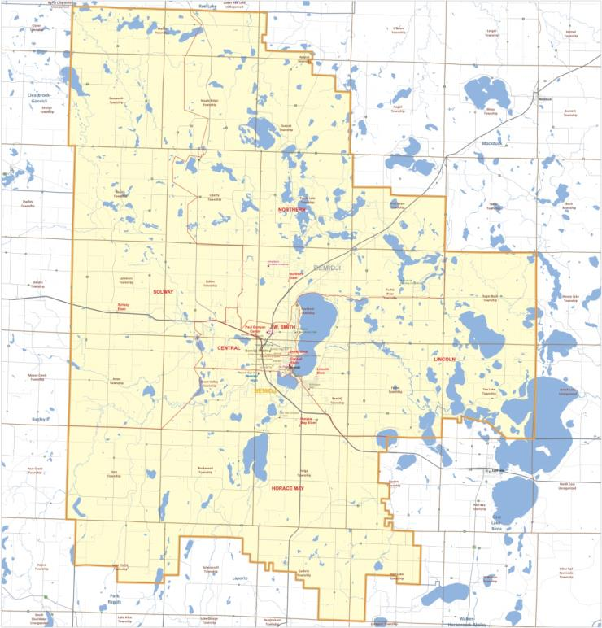
challenges
managing enrollment growth in a geographically dispersed district
District covers 825 square miles
As elementary school enrollment increases, it is a challenge to manage growth
Changing attendance borders can be very disruptive

Slide 6
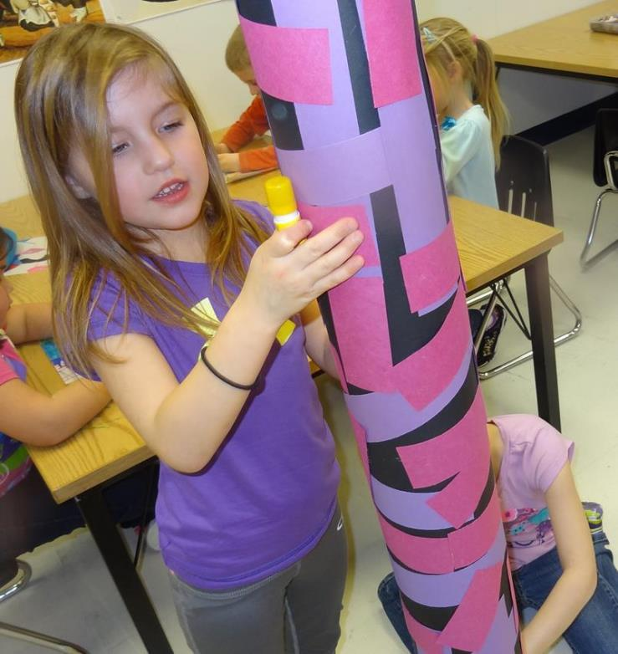
challenges
managing cost of growth
Some of the desired solutions – adding a small number of classrooms to each existing elementary school – are cost prohibitive and non-functional because some schools don’t have the core infrastructure to support them and some have already been added onto 3 and 4 times.

Slide 7
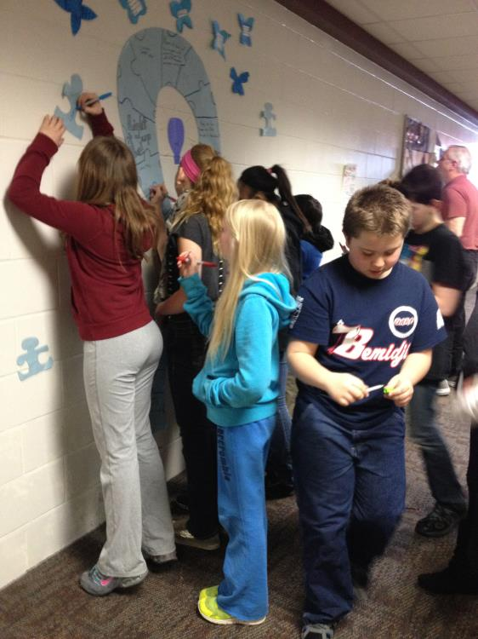
challenges
Aging infrastructure
at the Middle School
The heating, ventilation and air conditioning (HVAC) systems at the Middle School are 33 years old and have exceeded their useful lifespan
The HVAC system does not function well enough to meet new fresh air standards
The R-22 coolant used by our systems will be phased out of production by 2020

Slide 8
solutions
Manage enrollment growth
at elementary level
Option#1:
Build additions to existing elementary schools where possible
Option #2:
Construct a new k-5 elementary school and re-draw existing elementary school boundaries
Option #3:
Construct a new 4th & 5th grade elementary school and keep same k-3 school boundaries
Option #4:
Move 5th grade to middle school and 8th grade to high school
Cost prohibitive and
Non-functional
Doesn’t provide enough space
Less disruptive, more equitable, cost-effective
Proposed grade configuration is not desired

Slide 9
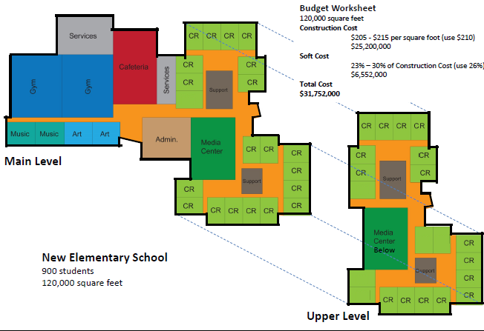
solutions
Build a new 4th & 5th grade
elementary school
Based on Lincoln Elementary prototype school – saves us time and money
Establishes equity for all 4th and 5th graders in the district
Less disruptive for the younger students (k-3)
Notes:
State reasons why?
Felt it was an opportunity to revitalize Middle School and get most for taxpayers dollar

Slide 10
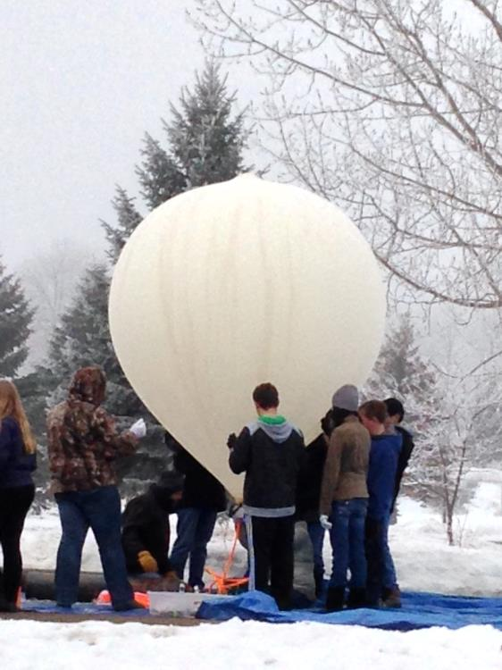
solutions
Address indoor air quality
at middle school
Option:
Replace existing heating, ventilation, air conditioning (HVAC) systems
Notes:
State reasons why?
Felt it was an opportunity to revitalize Middle School and get most for taxpayers dollar

Slide 11
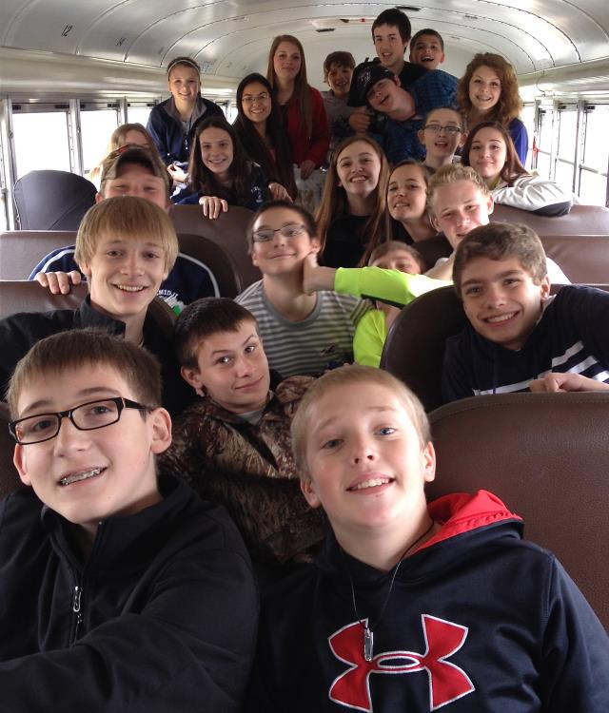
solutions
Replace HVAC system at
middle school
Improve indoor air quality and control humidity levels
Improve energy efficiency
Improve operating costs
Respond to EPA mandate to phase out R22 coolant
Notes:
State reasons why?
Felt it was an opportunity to revitalize Middle School and get most for taxpayers dollar

Slide 12
solutions
increase indoor
recreational space
Option #1:
Construct an indoor activity center
Option #2
Use athletic space in new elementary school
Cost prohibitive without significant partnership involvement;
timeframe did not support immediate need of addressing elementary enrollment growth
The proposed new elementary school will have two gymnasiums which can be used for other recreational activities during non-school hours
Notes:
State reasons why?
Felt it was an opportunity to revitalize Middle School and get most for taxpayers dollar

Slide 13
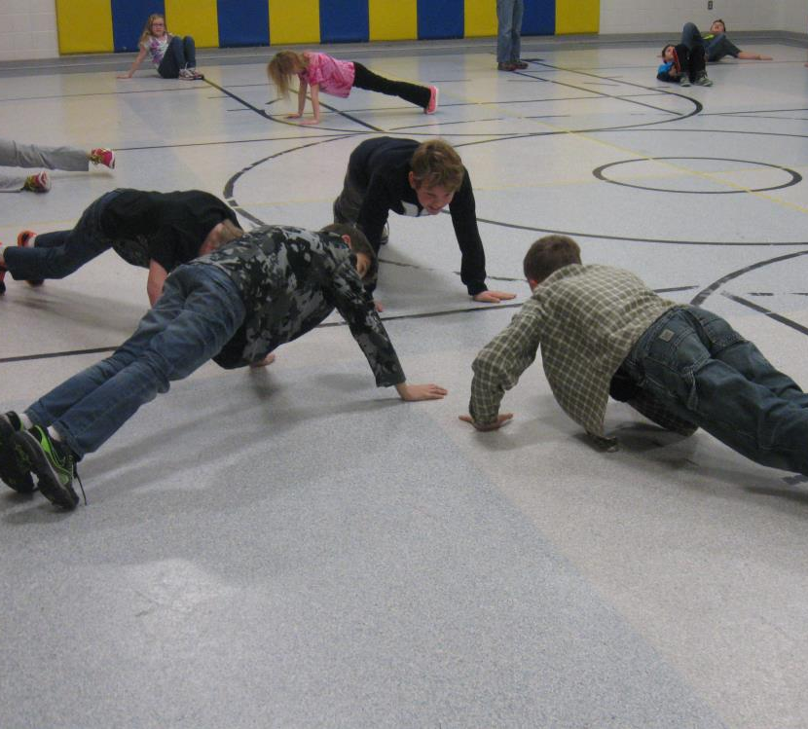
solutions
indoor recreation space
Utilize two new gym stations at elementary school
Continue dialogue with other local partners to resolve issue in a cost-effective manner for the entire community
Notes:
State reasons why?
Felt it was an opportunity to revitalize Middle School and get most for taxpayers dollar

Slide 14
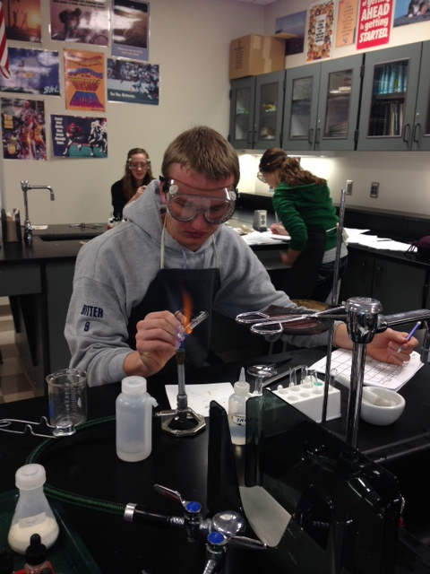
financial impact
project costs
The new 900-student, elementary school will cost an estimated $30M
The new HVAC system at the middle school will cost an estimated $4M
Capitalized interest for 4 years (maintaining a flat bond levy for 4 years) is $5.8M
The total bond request on November 4, 2014 is $39,815,000
An additional $180 per pupil in operating referendum will provide the funds to cover operational costs of $1M/year
Notes:
State reasons why?
Felt it was an opportunity to revitalize Middle School and get most for taxpayers dollar

Slide 15
financial impact
taxes
There will be two questions put to voters on November 4, 2014.
QUESTION 1 - requesting a $39,815,000 bond, will result in a 21 year continuation of the existing bond levy.
The minimal tax change is partially due to the fact that the district is refinancing its existing $17M debt.
QUESTION 2 - requesting a ten-year increase to the operating levy by $180/pupil, will result in an estimated tax increase of $2.71/month per $100,000 of Referendum Market Valuation, or $32.52 each year .
This Question 2 operating referendum tax impact will be reflected in your 2015 tax statement for taxes payable in 2016.

Slide 16
voting information
registration
^{Register to Vote deadline:}
You may register to vote until 4:30 p.m. on Tuesday, October 14, 2014. After this time, voter registration must be done in person on Election Day.
Absentee Ballot Request deadline:
All mailed early/absentee ballots must be RECEIVED by the Beltrami County Auditor by Tuesday, November 4, 2014 before 3:00 p.m. or they will not be counted. In-person absentee voting is available until 5:00 pm, Monday, November 3, 2014. After this time, voting must be done in-person on Election Day.
^{Forms Available:}
^{District office}
^{District website}
^{Beltrami County Courthouse}
Notes:
State reasons why?
Felt it was an opportunity to revitalize Middle School and get most for taxpayers dollar

Slide 17
voting information
voting day
BELTRAMI COUNTY Voting Locations:
(all voting locations will be open 7:00 am to 8:00 pm)
Bemidji Ward 1: America Indian Resource Center – 1630 Birchmont Drive NE
Bemidji Ward 2: National Guard Armory – 1430 23rd Street NW
Bemidji Ward 3: Boys & Girls Club Community Room – 1600 Minnesota Avenue NW
Bemidji Ward 4: City Hall Council Chambers – 317 4th Street NW
Bemidji Ward 5: Northwest Technical College Commons – 905 Grant Avenue SE
Alaska Township: Alaska Town Hall – 28982 Alaska Lane NW
Bemidji Township: Bemidji Town Hall – 148 Carr Lake Road SE
Buzzle Township: Pinewood Legion – 13269 Centerline Road NW
Eckles Township: Eckles Community Center – 9735 Cardinal Road NW
Frohn Township: Frohn Town Hall – 8769 Roosevelt Road SE
Grant Valley Township: Grant Valley Town Hall – 5408 Boot Lake Road SW
Lammers Township: Lammers Town Hall – 137 2nd Street NE
Liberty Township: Liberty Town Hall – 7721 Spencer Road NW
Northern Township: Northern Town Hall – 445 Town Hall Road NW
Port Hope Township: Port Hope Community Center – 9770 Hillcrest Drive NE
Roosevelt Township: Roosevelt Community Center – 25053 Debs Road NW
Turtle Lake Township: Turtle Lake Town Hall – 19143 Lake Julia Drive NW
Turtle River Township: Turtle River Town Hall – 9883 South Arm Court NE
Contact the Beltrami Auditor’s Office, 218/333-8448 if you need assistance on polling locations.
Notes:
State reasons why?
Felt it was an opportunity to revitalize Middle School and get most for taxpayers dollar

Slide 18
voting information
voting day
BELTRAMI COUNTY MAIL-IN BALLOTS ONLY:
Durand Township
Jones Township
Maple Ridge Township
Nebbish Township
Solway
Sugar Bush Township
Turtle River
Wilton
The Beltrami Auditor’s Office will mail ballots to all registered voters who reside in these townships. Contact the Beltrami Auditor’s Office, 218/333-8448 if you need assistance.
Notes:
State reasons why?
Felt it was an opportunity to revitalize Middle School and get most for taxpayers dollar

Slide 19
voting information
voting day
HUBBARD COUNTY Voting Locations:
(voting locations will be open 7:00 am to 8:00 pm, except as noted)
Farden Township: Farden Town Hall – 49702 315th Avenue
Fern Township Fern Town Hall – 47978 129th Avenue, 10am to 8pm
Guthrie Township: Guthrie Community Center – 44255 Rail Rd (NOTE: houses between 42769 & 43999 only),
Hart Lake Township: Hart Lake Town Hall – 43953 County Road 45
Helga Township: Helga / Nary Community Center – 25895 County Road 9
Lake Hattie Township: Lake Hattie Town Hall – 42229 County Road 3 (NOTE: houses between 44021 & 44387 only), 10am to 8pm
Rockwood Township: Rockwood Town Hall – 16962 County Road 9
Contact the Hubbard Auditor’s Office, 218/732-3196 if you need assistance on polling locations.
Notes:
State reasons why?
Felt it was an opportunity to revitalize Middle School and get most for taxpayers dollar

Slide 20
implications
yes / no
YES / YES
New elementary school for all 4th & 5th graders
Operational funding for new elementary school
Replacement of aged HVAC system at middle school
Two new community gymnasiums for indoor recreational use (outside of school use)
Additional space available for community needs
Increase taxes $2.71/month for Q2 and a 21 year extension of the current debt service levy for Q1
NO / NO
Move 5th grade to middle school
Move 8th grade to high school
Increased class sizes / overcrowding
Replace middle school HVAC system using health/safety local levy dollars – will delay other deferred maintenance and repair projects
District will be back to ask the voters again in the next General Election
Cost for improvements/additional space will increase (current construction cost escalation rates are 5.5% to 6% per year which would result in an additional $3.84M to $4.2M if we moved forward with the same solution in 2 years)
$3.4M decrease in taxes in 4 years

Slide 21
communication
stay informed
Community meetings
Date, locations posted on ISD #31 website
Weekly flyers
Starting week of September 14, 2014
District Website
www.bemidji.k12.mn.us
Contact Superintendent James Hess
218-333-3100 ext. 31120
jhess@bemidji.k12.mn.us

